Slide 1
Welcome to Natural Language Processing
Dr. M. Moshiul Hoque
CSE, CUET

Slide 2
Evaluation

Slide 3
Key Points
What & why NLP?
Steps involves in language processing: Morphological, syntactic, semantic, pragmatic, discourse integration
Parsing: bottom up vs. top down
Parser Implementation: ATN
Why semantic is important?
CFG/CSG/TGG

Slide 4

Any Light at The End of The Tunnel?
Yahoo, Google, Microsoft → Information Retrieval
Monster.com, HotJobs.com (Job finders) → Information Extraction + Information Retrieval
Systran powers Babelfish → Machine Translation
Ask Jeeves → Question Answering
Myspace, Facebook, Blogspot → Processing of User-Generated Content
Tools for “business intelligence”
All “Big Guys” have (several) strong NLP research labs:
IBM, Microsoft, AT&T, Xerox, Sun, etc.
Academia: research in an university environment

Slide 5
Natural Language Processing (NLP)
Natural Language?
Refers to the language spoken/written by people, e.g. English, Japanese, Bengali, as opposed to artificial languages, like C++, Java, LISP, Prolog, etc.
Natural Language Processing
Applications that deal with natural language in a way or another
Computers use (analyze, understand, generate) natural language
A somewhat applied field
Computational Linguistics
Doing linguistics on computers
More on the linguistic side than NLP, but closely related
More theoretical

Slide 6
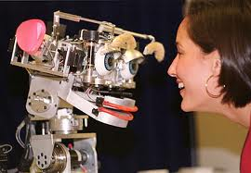
Why NLP?
Language is meant for communicating about the world
NLP offers insights into language
Language is the medium of the web
Help in communication
With computers
With other humans (MT)
HCI/HRI
Kismet: MIT Media Lab

Slide 7
Why NLP?
Classify text into categories
Index and search large texts
Automatic translation
Speech understanding
Understand phone conversations
Information extraction
Extract useful information from resumes
Automatic summarization
Condense 1 book into 1 page
Question answering
Knowledge acquisition
Text generations / dialogues
Applications for processing large amounts of texts
-require NLP expertise

Slide 8
Why BLP (Bangla Language Processing)
International Day of Mother Language [Feb. 01]
Widest possible distribution of Bangla

Slide 9

Social/Political Importance
More than one language

Slide 10

Commercial Importance
Highly paid job

Slide 11



Scientific Importance
Computer science

Slide 12
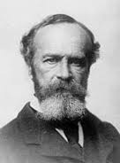
Philosophical Importance
Correct knowledge interpretation

Slide 13
NLP Involves ….
Two tasks:
Processing written text
-Lexical
-Syntactic
-Semantic
-Pragmatic
Processing spoken language,
-Lexical, Syntactic, Semantic, Pragmatic+++
- Phonology

Slide 14
NLP Involves ….
Natural Language Understanding (NLU): understanding & reasoning
while the input is NL
-Internal structure of the input NL
Natural Language Generation (NLG): generate other language
Natural Language Processing
Machine
NL Input
NL Output
Understanding
Generation

Slide 15
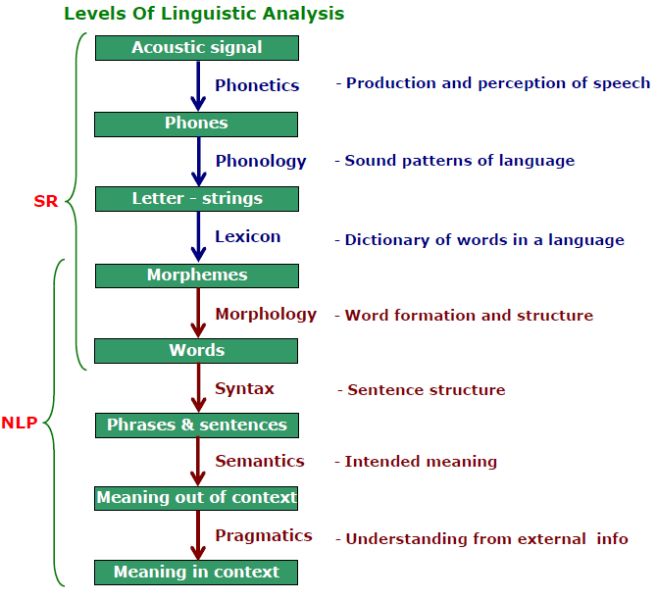
Linguistics and Language Processing
High-level
Low-level

Slide 16
Steps in the NLP
Morphological/Lexical Analysis: Individual words are analyzed into their components
-non-word tokens such as punctuation are separated from the words.
-Divide the text into paragraphs, sentences & words
Syntactic Analysis: Linear sequences of words are transformed into structures that show how the words relate to each other.
-Boy the go to store (rejected due to violate the rules)

Slide 17
Steps in the NLP
Semantic Analysis: The structures created by the syntactic analyzer are assigned meanings.
-Manush gass khai (syntactically correct but semantically not)
Discourse integration: The meaning of an individual sentence may depend on the sentences that precede it and may influence the meanings of the sentences that follow it.
-you wanted it (it depends on the prior discourse context)
Pragmatic Analysis: The structure representing what was said is reinterpreted to determine what was actually meant.
-commonsense knowledge
-Do you know what is it? (request)

Slide 18
Morphological Analysis
Morphology is the analysis of words into morphemes & conversely the synthesis of words from morphemes
Morphemes
-a smallest meaningful unit in the grammar
-a smallest linguistic unit that has semantic meaning
-a unit of language immediately below the ‘word level’
-a smallest part of a word that can carry a discrete meaning

Slide 19
Morphological Analysis
Example:
The word “unbreakable” has 03 morphemes
un- a bound morpheme
-break- a free morpheme
-able- a bound morpheme
Also, un: prefix, able-suffix--affixes
How many morphemes?
“aagniporikhha” “unreliable”,

Slide 20
Types of Morphemes
Free Morphemes:
-can appear stand alone/free
town, dog
-with other lexemes
town hall, dog house
Bound Morphemes
-appear only together with other morphemes to form a lexeme
un-: may be prefix/suffix
Inflectional Morphemes
-modify a word’s tense, number, aspects etc
dog morpheme with plural marker
morpheme s becomes dogs

Slide 21
Types of Morphemes
Derivational Morphemes
-can be added to a word to derive another word
Addition of “-nees” to “happy”: “happiness”
Root Morphemes
-primary lexical unit of a word. Roots can be either free or bound morphemes
chatters has the inflectional root chatter but the lexical root chat
Null Morphemes
-if is an invisible affix, also called zero morpheme represented as either the figure zero (0), the empty set symbol ∅, or its variant ∅
-Adding a null morpheme is called null affixation/null derivation/zero derivation;
cat = cat + -0 = ROOT (“cat”) + singular
cats = cat + - s = ROOT (“cat”) + plural

Slide 22
Syntactic Analysis
Syntax
-Syntax is the structure of language.
-It is the grammatical arrangement of the words in a sentence to show its relationship to one another in a sentence
-Syntax is a finite set of rules that specify a language
-Rules: Phase Structure Rules
Context-Free or Context-Sensitive
-Syntax rules govern proper sentence structure
-Syntax is represented by Parse tree:
-a way to show the structure of a language
fragment or by a list

Slide 23
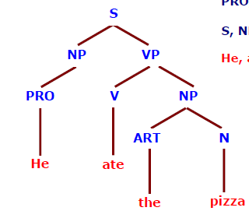
Syntactic Analysis
He ate the pizza
PS Rules
S→ NP VP
NP → PRO
NP → ART N
VP → V NP
Input String
Parser
Lexicon
V-ate
PRO-he
N-pizza
ART-the
Parse Tree

Slide 24
Classification Phrases
Sentence (S)
Noun Phrase (NP): Noun/Pronoun as head
-Optionally accompanied by a set of modifiers
Determiners: article (the, a)
Adjectives (the red ball)
the black cat, a cat on the mat
Verb Phrase (VP): verb as head
“eat cheese”, “jump up and down”
Adjective Phrase (AP): adjective as head
full of toys, good boy
Adverbial Phrase (AdvP): adverb as head
very carefully
Prepositional Phrase (PP): preposition as head
in love, over the rainbow

Slide 25
Classification Phrases
Determiner Phrase (DP): determiner as head
a little dog, the little dogs
In English, determiners are usually placed before the noun as a noun modifier that includes:
-articles (the, a),
-demonstratives (this, that),
-numerals (two, five, etc.),
-possessives (my, their, etc.),
-quantifiers(some, many, etc.)

Slide 26
PS Rules
PS rules are a way to describe language syntax.
Rules determine what goes into phrase & how its constituents are ordered.
They are used to break a sentence down to its constituent parts namely phrasal categories & lexical categories:
Phrasal category include: noun phrase, verb
phrase, prepositional phrase
Lexical category include: noun, verb,
adjective, adverb, others

Slide 27
PS Rules
PS rules are usually of the form A → B C
-meaning “constituent A is separated into sub-constituents B & C
-Or simply “ A consists of B followed by C”
S → NP VP Reads: S consists of an NP followed by a VP
-Means a sentence consists of a noun phrase followed by a verb phrase
NP → Det N1 Reads: NP consists of an Det followed by N1
-Means a noun phrase consists of a determiner followed by a noun

Slide 28
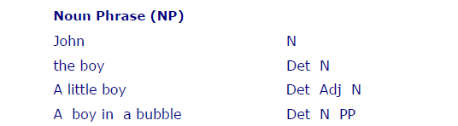
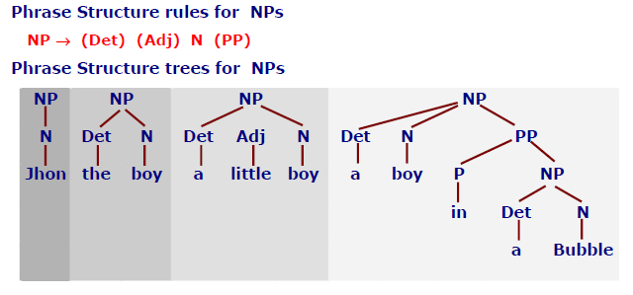
PS Rules and Tress for NP

Slide 29
PS Rules
S→ NP VP
NP → (Det) (ADJS) N
NP → PRO
NP →PN
ADJS → ADJ |ADJS
VP → V (NP)
N → file|printer
PN → Bill|Rahim|Bird
PRO → I|he|she
Det → the|a|an
ADJ → short|long|want|red
V → printed|created|want
Bill printed the red file
S
NP VP
PN
V NP
Bill
printed
Det ADJS N
the
ADJ
file
red

Slide 30
Parser
A parser is a program, that accepts as input a sequence of words in a natural language and breaks them up into parts (nouns, verbs, & their attributes), to be managed by other programming.
Parsing can be defined as the act of analyzing the grammatically an utterance according to some specific grammar
Parsing is the process to check, that a particular sequence of words in sentence correspond to a language defined by its grammar
Parsing means show how we can get from the start symbol of the grammar to the sentence of words using the production rules
The output of a parser is a parse tree/Structural Representation (SR)

Slide 31
Properties of a Parse Tree
Parse tree is a way of representing the output of a parser
Each phrasal constituent found during parsing becomes a branch node of the parse tree
Every node corresponds either to an input word or to a non-terminal
Each level in the parse tree corresponds to the application of one PS rule
The words of the sentence become the leaves of the parse tree
There can be more than one parse tree for a single sentence

Slide 32

Conclusion
Why NLP is important?
Steps involves in language processing
Morphological analysis
Syntactic analysis using PS rules
Structural Representation (SR): Parse tree
Topics Covers:
Artificial Intelligence: Rich & Knight
Artificial Intelligent & Expert System: Patterson

